Slide 1
Asset Management
May 29, 2025
Owen Philip
Senior Manager, Capital Planning
BC Housing

Slide 2

Agenda
Assessments
Data Management
Projecting Planning & Prioritization
Asset Planner Demonstration
Q & A

Slide 3
Why assess?
Assessment Data
Provides the owner with data used to plan and prioritize capital projects
Capital Plan

Slide 4



What is a Building Condition Assessment?
Repair Needs
Building Lifespan
Safety
A building condition assessment (BCA) is an educated opinion of the current condition of the elements that comprise the property.
It will include opinions about years and costs for actions (repairs or replacements) that might occur, to keep the building in a target condition.
A BCA is meant to give the owner a general idea of condition of the building. It is a non-invasive, visual inspection.

Slide 5
Replacement costs
are the Current Replacement Values (CRV) for the building components or elements.
Action Costs
is the cost of a project that is being planned for a particular component
Action Year
is the year in which a future project is planned

Slide 6
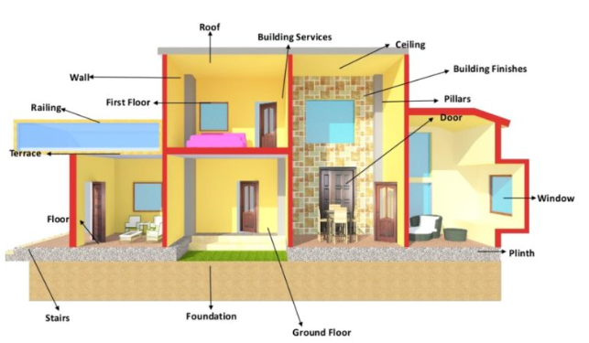
Typical “Actions”
Replace the roof
Paint the siding
Repair major foundation crack
Replace the windows
Replace the furnace
Replace the water heater
Replace the carpet
Paint the interior walls and etc.

Slide 7

Targeted Assessments
Investigation of a specific building system
Can be invasive (exploratory openings, etc…)
Provide recommendations for remediation
Provide more accurate project budgets
Typically conducted and signed off by a professional (Engineer, Architect etc.)

Slide 8


What is a Capital Plan?
A capital plan is simply a spreadsheet that contains information about future liabilities, projects and funding strategies for properties that we are responsible for over a thirty year window.

Slide 9

Commonalities between Capital Plans
Inventory of components that make up the building.
Repeat interval for the repairs
1
5
List of repairs needed over 30 years
Funding sources for repairs
(if known)
2
6
3
Cost of repairs
7
Opening balance and annual contribution; closing balance
.
4
Shortfall or surplus
Year in which repairs will occur
8
*All of the above items are subject to change

Slide 10
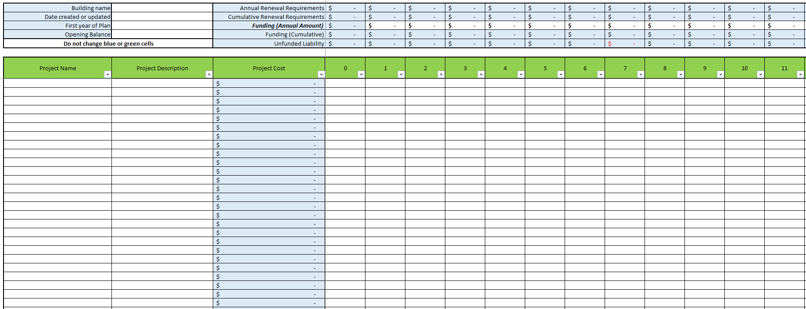
Capital Plan Example

Slide 11
Data Management

Slide 12

What do I do with all of this information?

Slide 13

What makes good data??
Useable
Accessible
Familiar
Legible (naming conventions)
Fresh
Project/Maintenance Tracking
Reporting

Slide 14


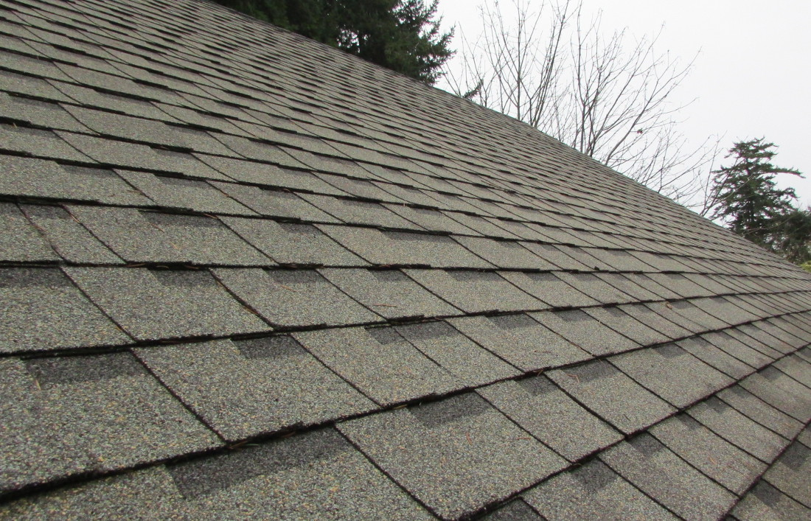



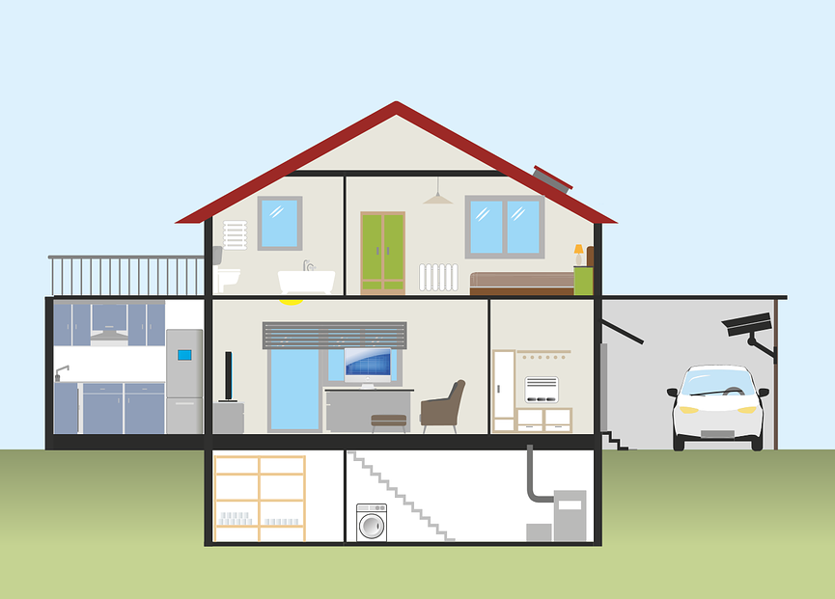
Facilities Condition Index : Calculation
Etc….
$ Replace plumbing
$ Replace windows
$ Replace roof shingles
$ Painting
$ Replace siding
FCI =
$ Whole building Current Replacement Value

Slide 15
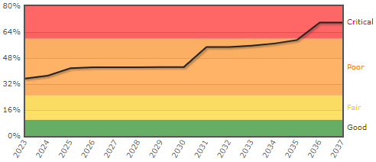
Facilities Condition Index
The quality rating from Ameresco for FCI is as follows:

Slide 16
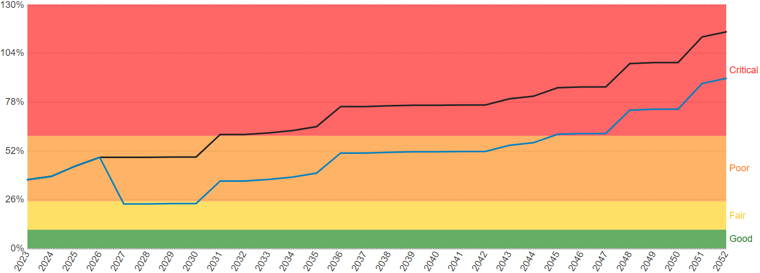
Improving Facility Condition Index
This FCI graphs shows this particular building reaching a critical FCI by 2031 if no An investment in 2026, show a dip in FCI improved. This building will now reach a critical FCI in 2034 if no further spending happens after 2045.

Slide 17
Project Planning & Prioritization

Slide 18
SAFE. WARM. DRY.

Slide 19
Prioritization Factors
Life Safety Risk
Business Case
1
5
Critical Infrastructure
Length of Prior Deferral
2
6
Priority
Level
Service Life Remaining
Overall Building
Condition
3
7
Service Life Impact
External Influence
4
8

Slide 20
Project Budgets
Capital projects require a budget. Ideal to be as accurate as possible. Some key factors to keep in mind when creating a budget
Consulting
(prime and other)
Construction
(break down by discipline)
Contingency
(percentage of total budget or quantified risk)
Owner costs
(insurance, hazmat survey, performance testing)

Slide 21
Resources
Contractors
  Engineers
  Building/Property Managers
  Building Science Technicians
  Architects
  Site Staff

Slide 22
Final Thoughts

